Slide 1
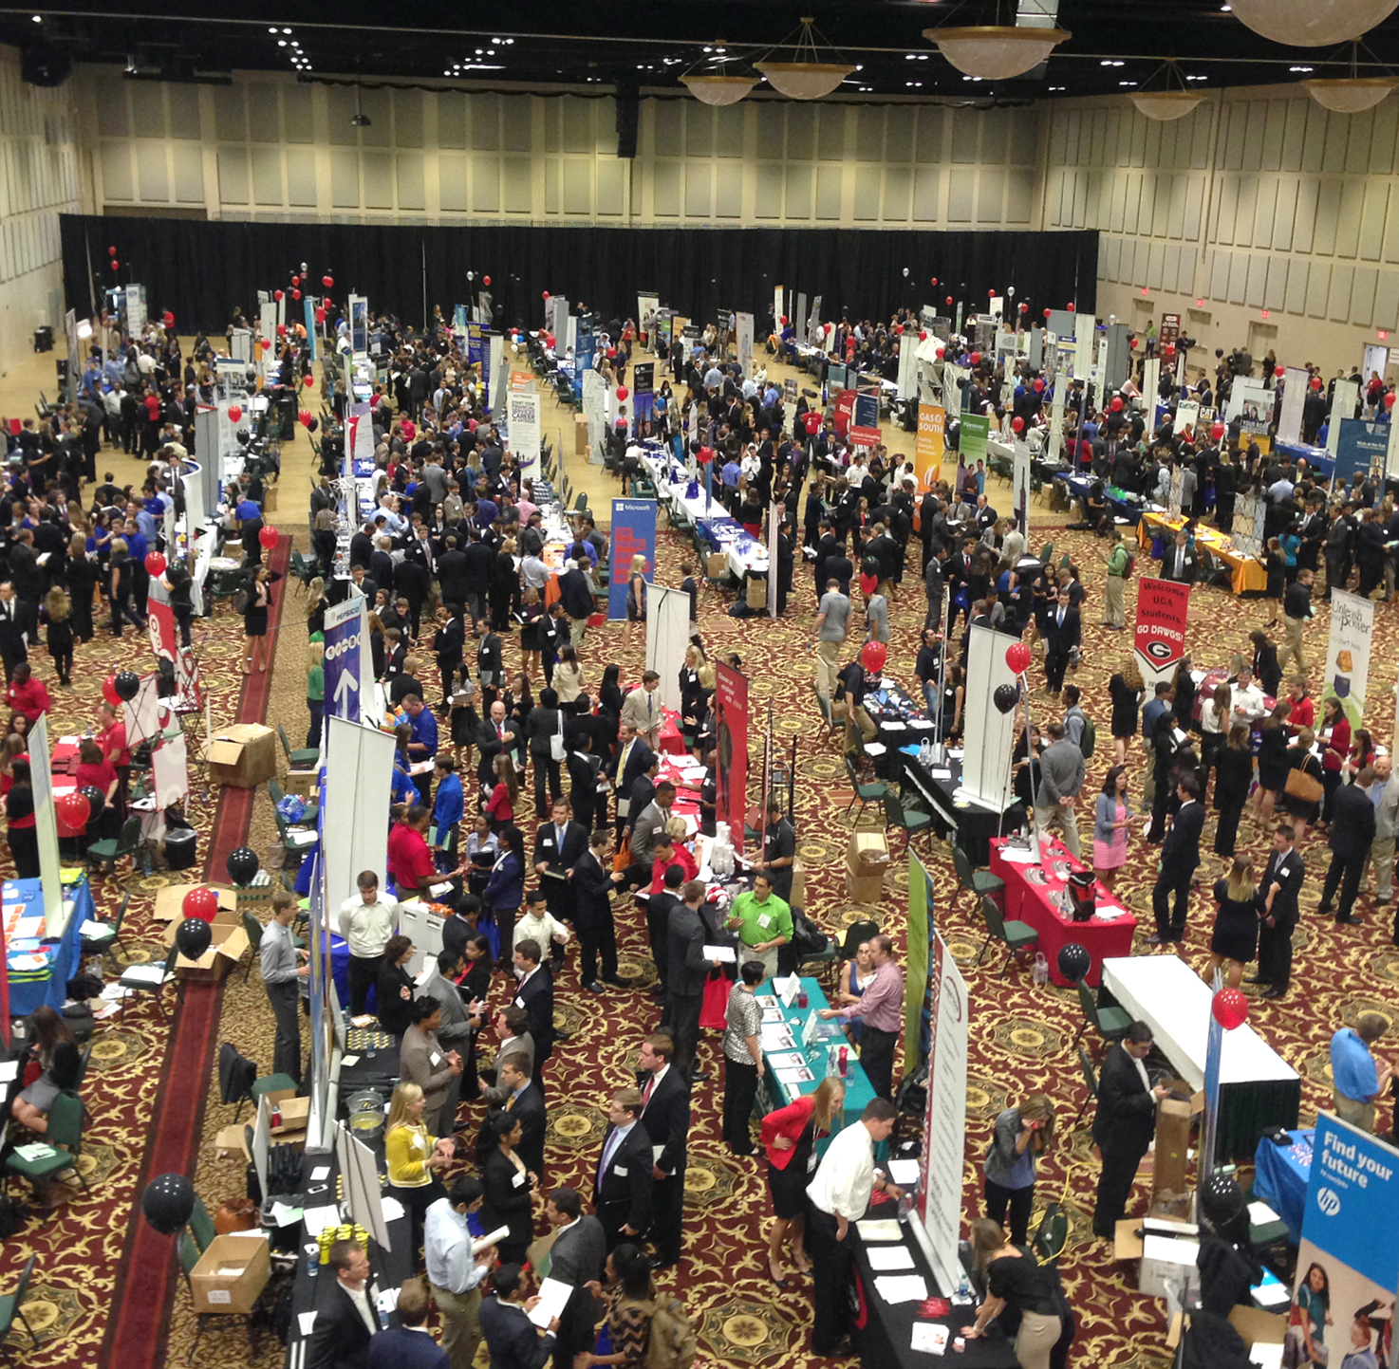
UGA Fall Career Fair & Engineering Career Fair
244 employers at UGA Fall Career Fair next Monday (12-5pm)
195 signed up for the UGA Engineering and Computer Science Career Fair next Tuesday (3:30-7:30pm)

Slide 2
UGA Career Fair Checklist
Before the Career Fair
At the Career Fair
Dress for success
Review your resume
Memorize all your bullet points
Have at least 20 copies
Apply in advance
Top target list
Research top target list
Have pitch ready
Have questions ready
Arrive early
Review map and plan route
Practice with non-target companies
Plan to walk through every row of employers
Try to have a conversation
After the Career Fair
Get connected
Follow up

Slide 3

Dress for Success
Note dress recommendations on the fair registration:
Choose a professional outfit
Carry a folder or padfolio with your resume and business cards
Remember to set your phone to silent and dispose of gum or mints prior to talking to a recruiter

Slide 4

Review Your Resume
Memorize all your bullet points
Bring 20+ printed copies to the fair to give to your target employers

Slide 5
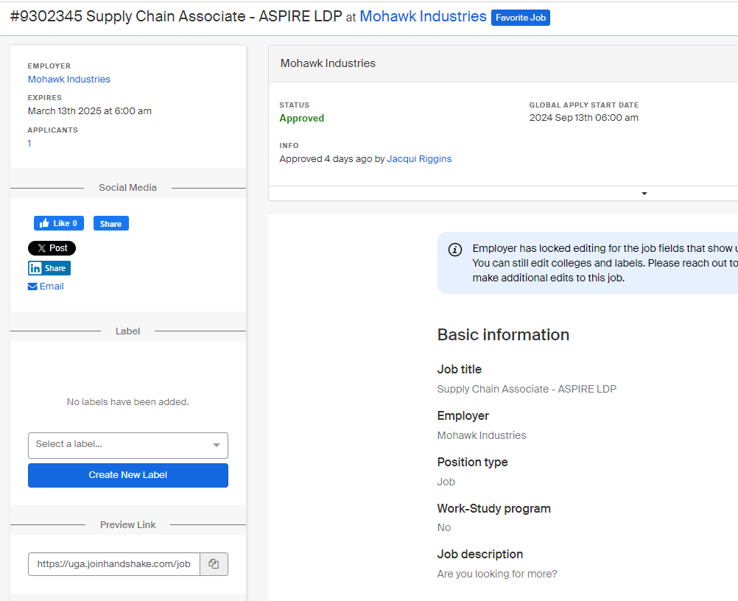
Apply in Advance
Apply via Handshake
Apply directly on career website

Slide 6
Research Target Companies
What is the organization’s mission/vision?
Where is the company located?
How many people are employed there?
What products or services do they provide?
How old is the company?
What is the organizational structure and how would this role fit into that?
Who are the company’s main competitors?
What are some major trends in the industry?
How do they present themselves on social media? The news? What is their brand?
How do they describe themselves?
How do they want the person in the position to contribute to the role and the team?
How do you match their profile? What examples do you have to show that?
How can you help them achieve their goals?
Do the company’s values align with your own?

Slide 7
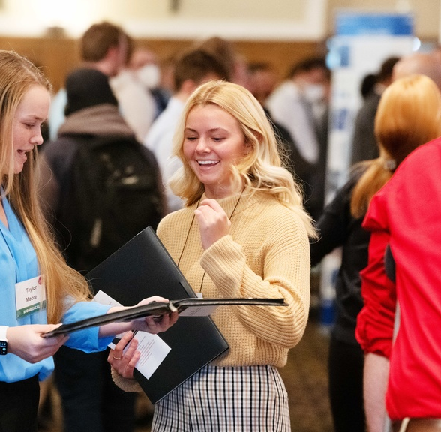
Have pitch ready
Brief
Persuasive
Confident/competent
Pitch bonus points:
Customized
Knowledgeable
Prepared
Practice on Big Interview!

Slide 8
Possible pitch openings:
I'm a finance major now in the Analytics master's program looking for opportunities that build upon my internship last summer in [fraud detection analytics]…
I'm currently in the Master of Business Analytics program and I applied to the [Supply Chain LDP] role over the weekend...
I've been looking for [Mohawk] here today!. When researching companies who will be here today, your [innovations in sustainable flooring] really stood out to me…
I've recently spoken with [John Smith], who is a [Senior Data Analyst], and based on our conversation I’m excited to learn more about your [BI team that has been growing rapidly]…
Hi, thanks for being here today. How are you?

Slide 9
Putting it all together: some examples around 20 seconds long
I’m John, now in a Master’s in Business Analytics after finishing my finance undergrad last May. I spent last summer at MasterCard as an Innovation Intern on a product team, where I performed risk analysis around a new product launch. I’m graduating in May and looking for a quantitative role within a product team. Thanks for chatting with me.
I'm currently in the Master of Business Analytics program and I applied to your Supply Chain LDP role over the weekend. My undergrad major was Management with a supply chain emphasis, and I’ve had two supply chain internships: one was in a manufacturing environment and another was with a larger retailer. What types of rotations have there been previously in this Supply Chain LDP?
I've been looking for Mohawk here today! I’m looking for roles in Georgia outside of the Atlanta metro. I grew up around the construction industry, and I’ve long admired your continuous innovations in sustainable flooring. I’ll be applying to your ASPIRE LDP program, but I’m interested in two of these programs: Sustainability and Sales Ops. Would you recommend that I just chose one or apply to both of these opportunities?

Slide 10
The goal of a pitch is to have a compelling conversation starter, that can lead to follow up questions like:
When do opportunities in [marketing analytics] typically get posted?
How big of a cohort are you targeting for [the LEAD program]?
I've only seen [accounting] roles posted recently. What's the hiring timeline for [financial analyst] positions?
Who do you recommend I connect with for positions on the [quantitative solutions] team?
What do opportunities look like at the end of the two years of rotations?
Can I connect with you on LinkedIn and reach out when I see [marketing analytics] roles posted?
I've actually already applied to the [Business Solutions Consultant] role. What's your advice for how to stand out from here?

Slide 11

Have a Plan
Have 20-30 resumes printed
Identify your top 10-20 companies, but plan to pitch to more than that
Review Employer Map and Plan Route
Be open to approaching a company you're not familiar with to “practice” your pitch a few more times

